Slide 1
Welcome! Class will begin at 11:00am.
Notes:
This class will not be recorded
I will send out slides, a handout, and a link to the class evaluation after our session
Feel free to post questions in the chat at any time (or unmute yourself)
My email: helenmary@pitt.edu

Slide 2

Preparing for the New NIH Data Management & Sharing Plan (DMSP)
Session 2
Where to Share Data
Helenmary Sheridan
Data Services Librarian, HSLS
helenmary@pitt.edu

Slide 3
Data Services @ HSLS
HSLS Data Services offers support, consultations, and customized trainings to help you:
Organize your research data before, during, and after collection
Write a data management plan (DMP)
Use electronic research notebooks
Preserve your data for long-term use
Use data effectively
Create effective data visualizations
Locate existing datasets for reuse
Cite datasets accurately
Share your research data
Comply with data sharing policies
Identify appropriate data repositories
Prepare datasets for sharing with documentation and metadata
Increase the reproducibility of your research
Create READMEs, data dictionaries, and code annotations
Manage code with version control
Select licenses for your code and datasets
Adopt principles of open science and join a community of open science practitioners

Slide 4

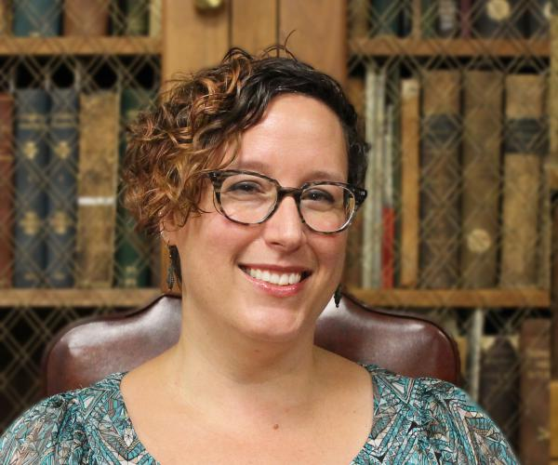

Data Services @ HSLS
Melissa Ratajeski, Asst. Dir. for Data and Scholarly Publishing
Carrie Iwema, Coordinator of Basic Sciences
Helenmary Sheridan, Data Services Librarian
Data Services Libguide: https://hsls.libguides.com/data
Email contact: hslsdata@pitt.edu

Slide 5
Goals for this workshop
Review the new NIH Data Management and Sharing Policy
Look at official guidance for selecting a repository
Flowcharts, decision trees, and checklists
Put together tools for evaluating repositories
Talk about your data needs
My main goal: that everyone feels equipped to take the first steps towards sharing data in compliance with the policy

Slide 6
Final NIH Policy for Data Management and Sharing
Applies to all research funded to any degree by NIH that results in the generation of scientific data
Does not apply to activities that don’t generate scientific data, like training, infrastructure development, or “non-research activities”
Goes into effect for all applications submitted on or after January 25, 2023, or any activities/agreements executed thereafter
Expects researchers to share as much data as possible while keeping a balance with confidentiality and other sensitive data concerns

Slide 7
Policy FAQ
Q: Can we update our plans once submitted?
A: Yes, subject to NIH ICO approval
Q: Are we really expected to share ALL our non-confidential, non-sensitive data?
A: Yes and no. If you collect a lot of data and throw out half of it as a routine matter, you don’t need to share that junk data. It’s up to your judgment what constitutes “scientific data.” But you do need to share all your meaningful data, even if it’s really, really big or really, really small.
Q: Will this affect Data Use Agreements?
A: Probably not, but you can watch for updates from OSP
Q: Will this affect grants in place prior to January 25, 2023?
A: No, unless you are re-submitting

Slide 8
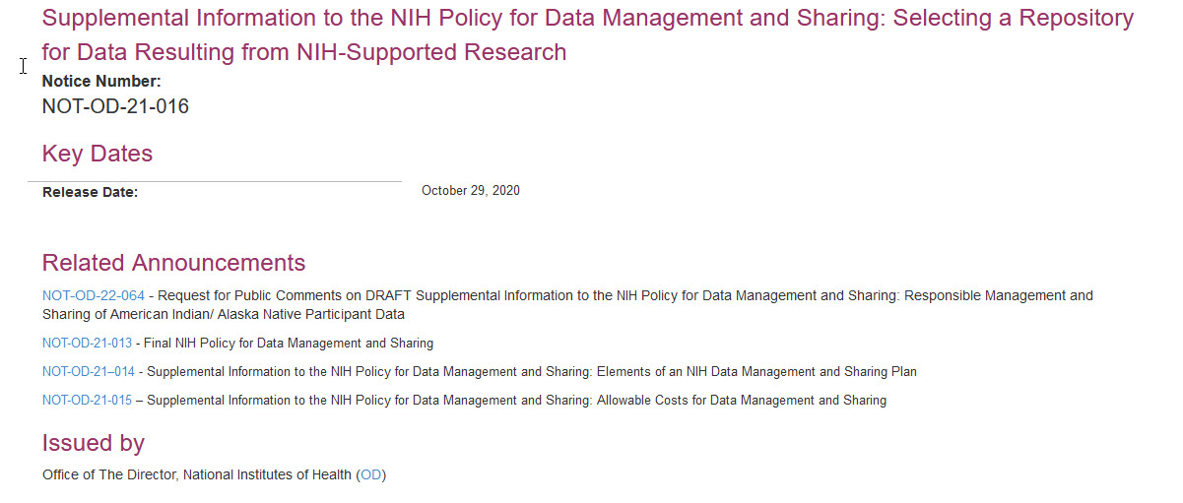
Official NIH Guidance on Choosing a Repository
https://grants.nih.gov/grants/guide/notice-files/NOT-OD-21-016.html

Slide 9
Priorities for choosing a repository
For some programs and types of data, NIH policies and funding announcements specify the repository to be used.
Second-best: a discipline- or data-specific repository, ideally taken from the NIH list: https://www.nlm.nih.gov/NIHbmic/domain_specific_repositories.html
Third-best:
Uploaded as supplementary material to accompany PubMed Central articles (if <2 GB in size)*
Generalist or institutional data repositories
Cloud-based data repositories (if very large)
* The NIH may approve of this option, but I don’t like it. You lose the benefits of having your data independently discoverable on the web.

Slide 10
Activity: Discipline-Specific Repositories
Open the NIH list of open domain-specific data sharing repositories (https://www.nlm.nih.gov/NIHbmic/domain_specific_repositories.html) and look at the options. Do you see a repository that might fit your data? (Note that the table spans two pages.)

Slide 11
Discipline-Specific Repositories
Q: I know of a repository for my subject that isn’t on the NIH list. Can I use it?
A: It depends! How robust is it? Do you think it will still be around in 10 years? Are your colleagues using it? For more specific guiding questions, see the checklist in Section I of the Supplemental Information, “Desirable Characteristics for All Data Repositories”

Slide 12
Generalist Repositories
Generalist repositories take scientific data from ALL disciplines. Often they take other material too: publications, code, video, posters, slide decks…
Excellent choice if you have lots of types of research products and want to keep everything in one place
Come in free or paid versions, and can provide no data curation or lots of it
All the desirable characteristics listed in the Supplemental Information still apply—not all generalist repositories are created equal

Slide 13

Generalist Repository Spotlight: Dryad
Excellent quality generalist data repository
Cost: $120 per data submission, with storage fees for data over 50GB
Size limits: 300GB per data publication; higher sizes available on request
Confidentiality requirements: No PIH allowed
Issues DOIs

Slide 14

Generalist Repository Spotlight: Figshare
Good quality generalist repository that accepts EVERYTHING
Cost: free
Size: 20GB (total and per-file), or paid option (figshare+) for large files
Issues DOIs

Slide 15

Generalist Repository Spotlight: Zenodo
Excellent quality generalist repository that takes data, code, and other supplementary information (any format)
Cost: free, but excess file size fees may apply
Size limits: 50GB per record
Must not violate confidentiality and respect PIH
Issues DOIs

Slide 16
Next session: how to actually deposit data
Preparing for the New NIH Data Management & Sharing Plan: Session 3 -- Documentation, Metadata, and the "How" of Deposit
Instructor: Helenmary Sheridan Date: April 22, 2022 Time: 1:00pm to 2:30pm Location: Online, Online - synchronous Register for this class

